Slide 1
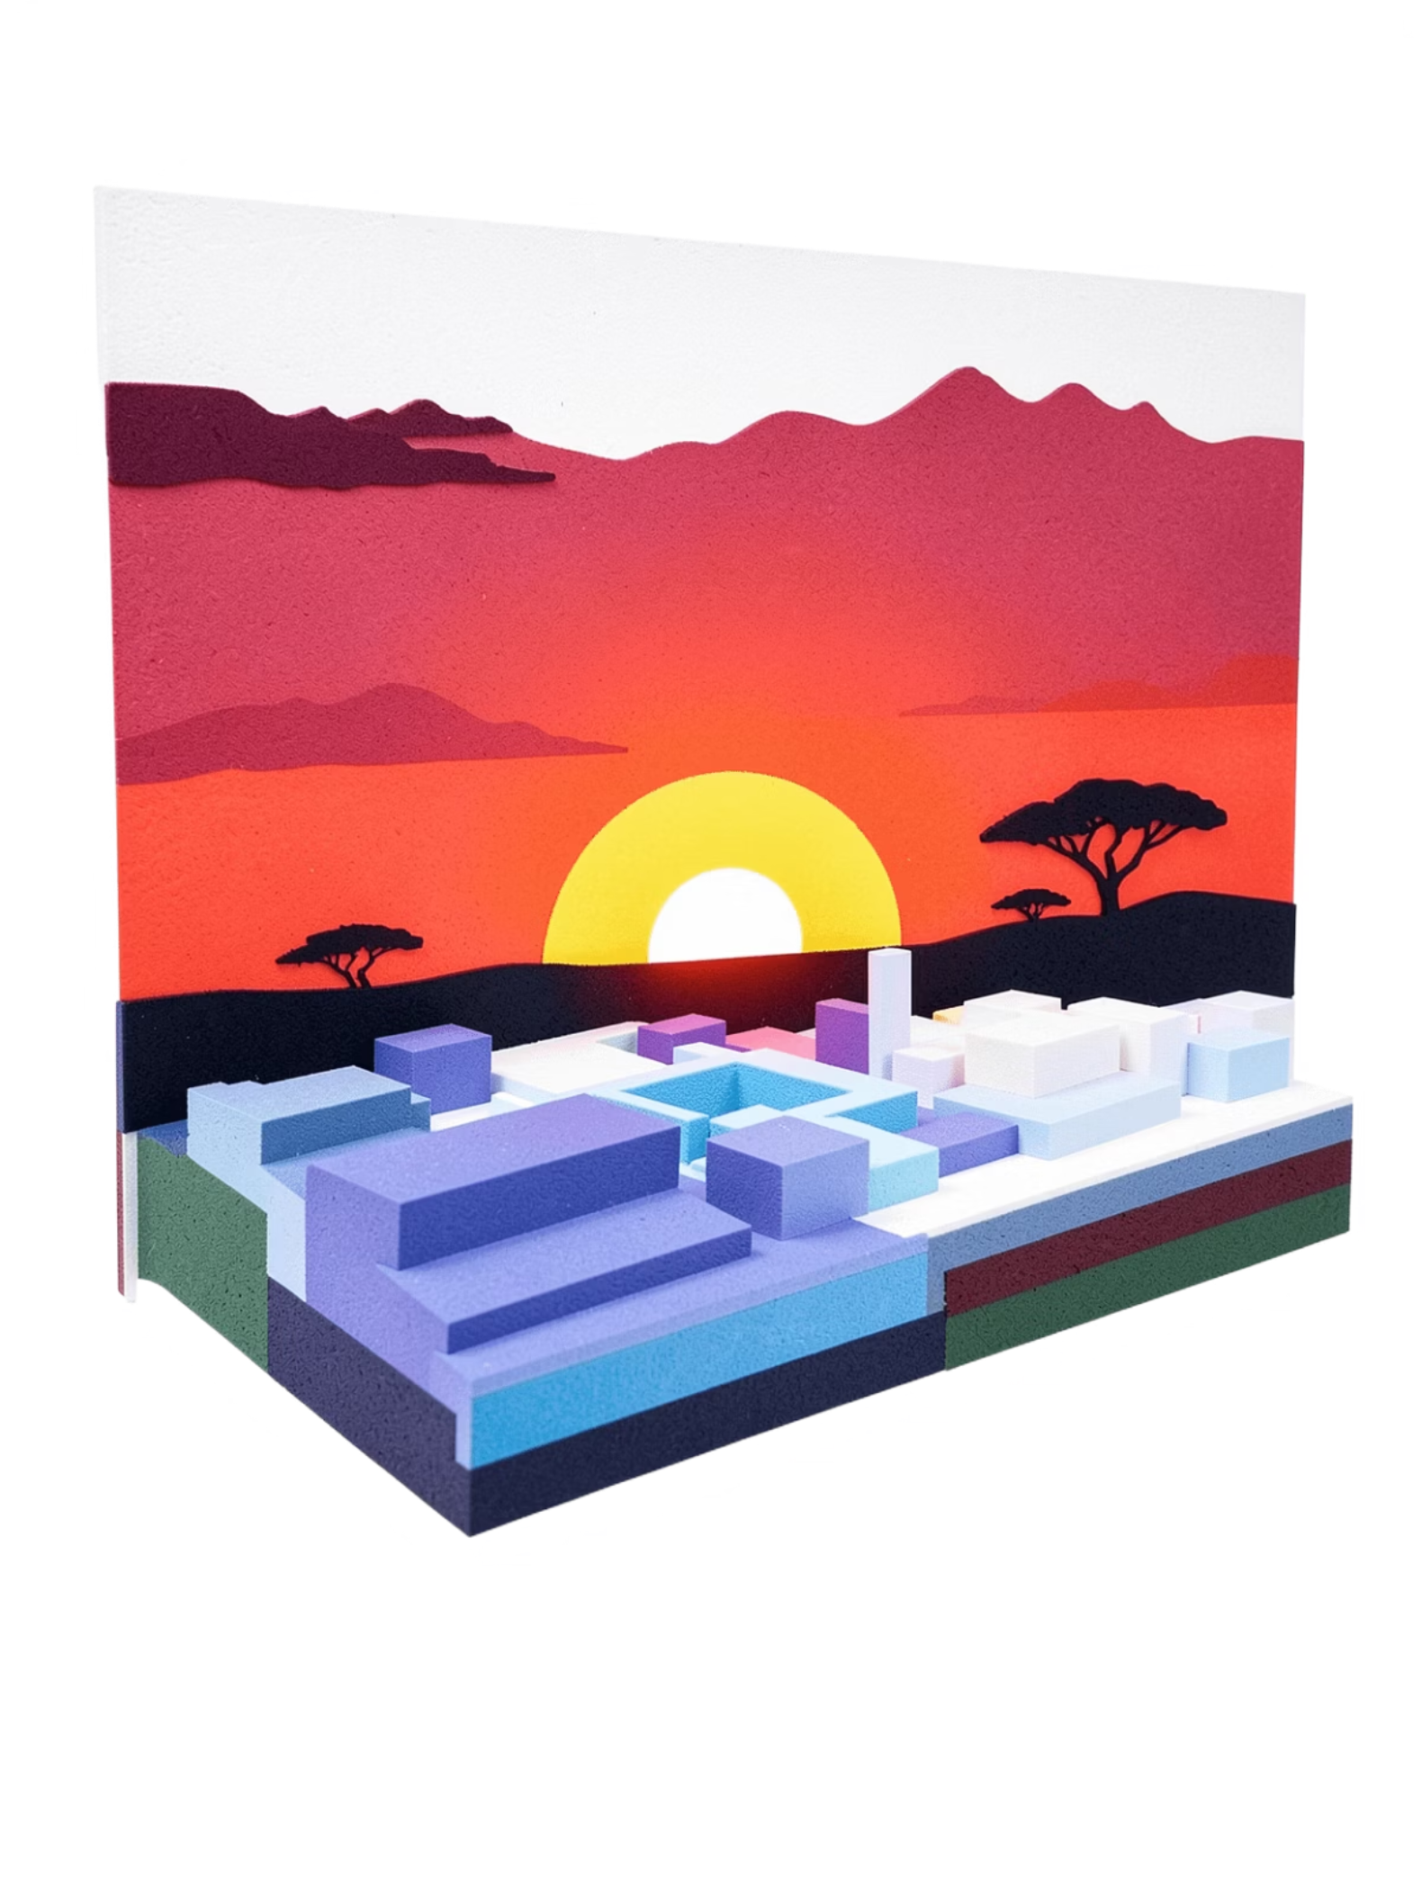
African History: A Long Walk to Freedom
Political Emancipation and the Legacy of Nelson Mandela
Presented by: Viraj Chavan | Class: 10th B | Subject: English

Slide 2


INTRODUCTION
The Dawn of Emancipation
In the mid-20th century, Africa was a continent in turmoil — colonized, divided, and suppressed under foreign rule for centuries. Political emancipation refers to the hard-fought process by which African nations gained independence and established their own sovereign governments.
Colonial Africa
The Fight for Freedom
By 1900, nearly 90% of Africa was under European control, with resources exploited and local cultures suppressed.
Nationalist movements rose across the continent, demanding self-rule, dignity, and the right to govern their own lands.
Nelson Mandela
His life and struggle became the most powerful symbol of this continental fight for equality, justice, and liberation.

Slide 3
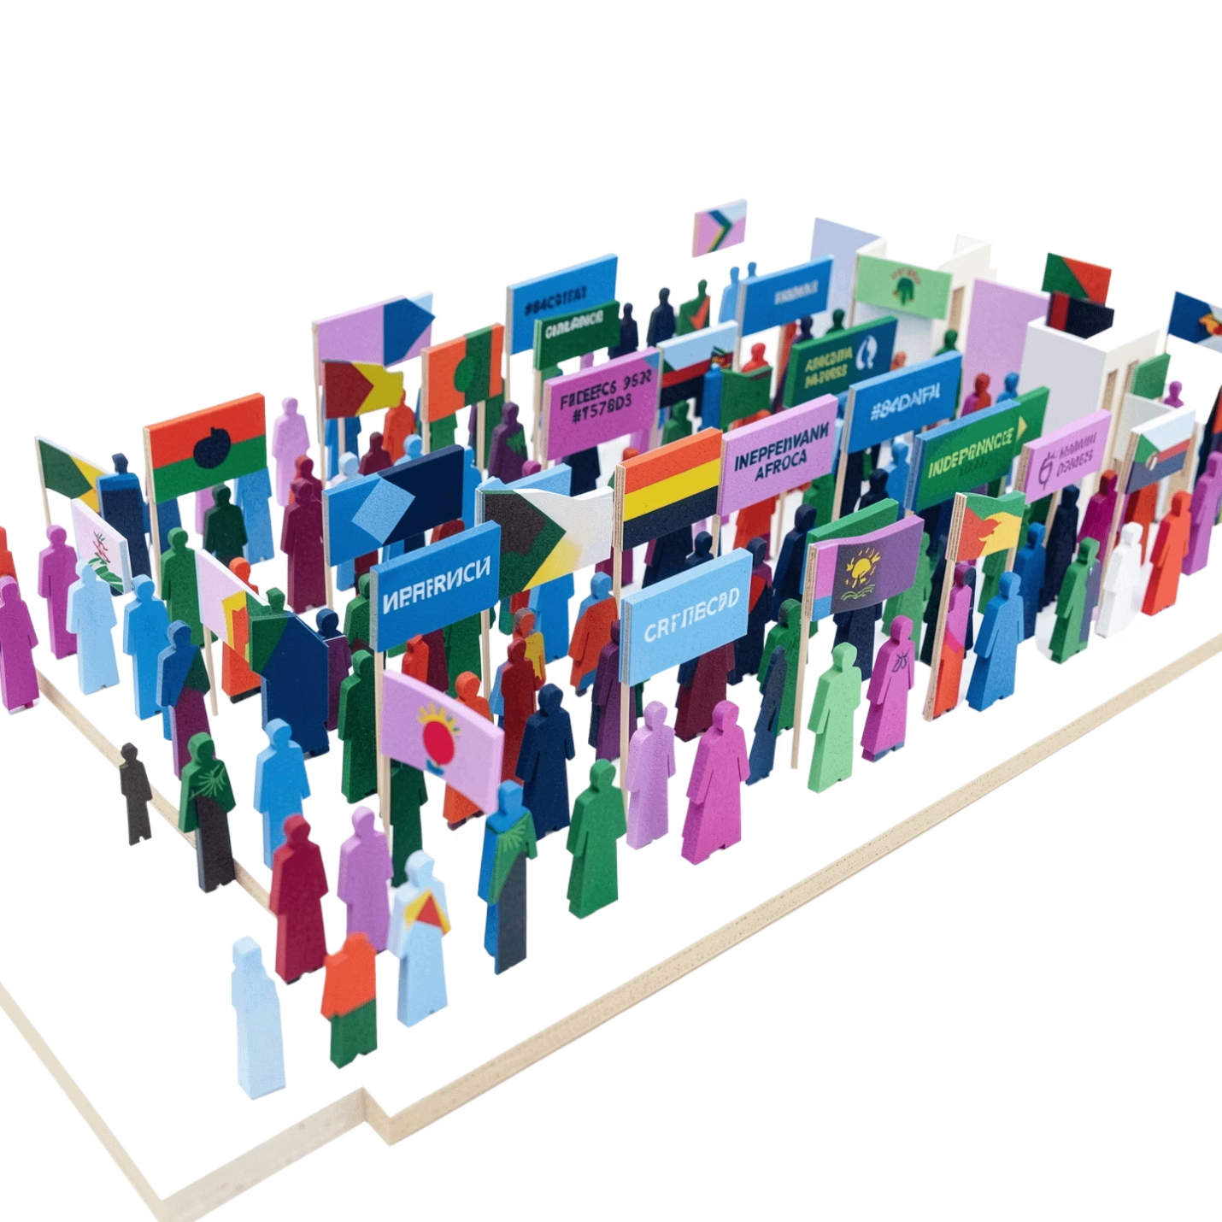

CHAPTER 1
The Seeds of Resistance: Early Struggles
Colonialism's Devastating Impact
European powers carved Africa into artificial borders with no regard for ethnic or cultural boundaries. Indigenous peoples were stripped of land, resources, and identity. Forced labor, violence, and systemic oppression became the daily reality for millions across the continent.
The Rise of Nationalism
Despite brutal suppression, African voices of resistance grew louder. Thinkers like Kwame Nkrumah of Ghana, Jomo Kenyatta of Kenya, and Patrice Lumumba of Congo inspired generations. They argued that Africans had the right to self-determination and that colonialism was morally indefensible.
Key Fact: Between 1957 and 1975, over 30 African nations gained independence — a wave of liberation known as the "Year of Africa" in 1960 alone saw 17 nations break free.

Slide 4
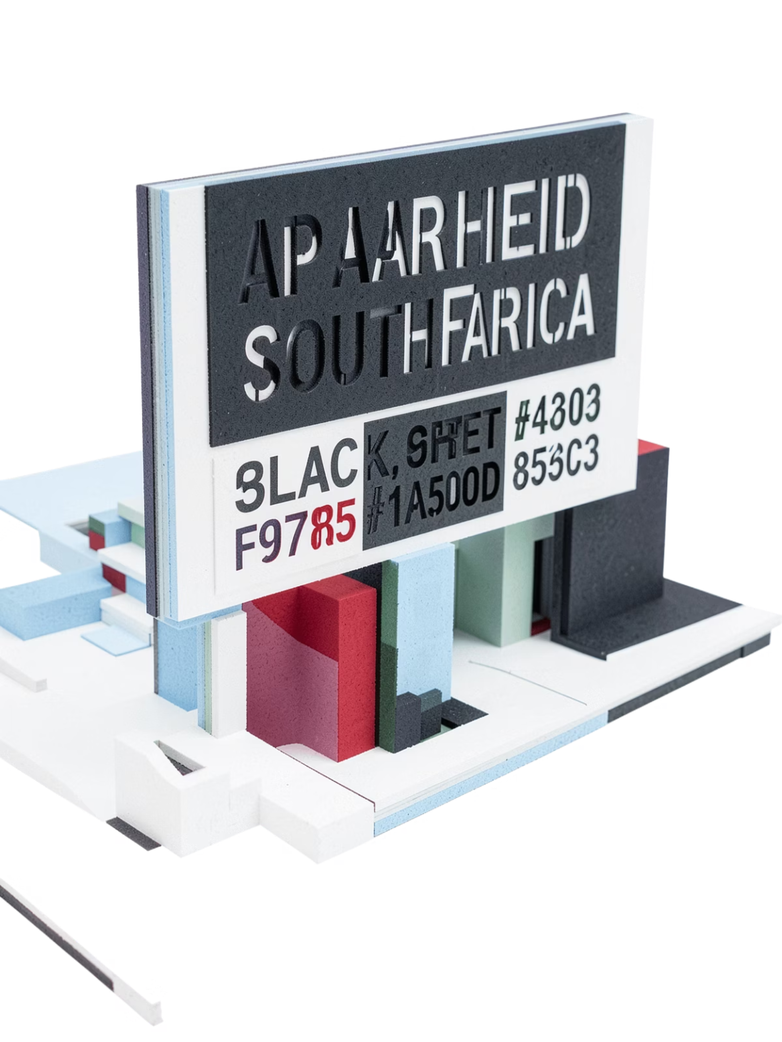
CHAPTER 2
Apartheid's Grip: The South African Context
From 1948 to 1994, South Africa was governed under apartheid — a brutal system of institutionalized racial segregation. The word means "apartness" in Afrikaans. Under apartheid, Black South Africans were stripped of citizenship, forced into impoverished "homelands," denied quality education, and subjected to humiliating daily discrimination.
Pass Laws
Black citizens were required to carry passbooks at all times, restricting their movement and confining them to designated areas.
Bantu Education
A deliberately inferior education system was designed to prepare Black South Africans only for menial labor, not leadership.
Forced Removals
Millions of Black families were violently uprooted from their homes and relocated to barren, underdeveloped townships.

Slide 5
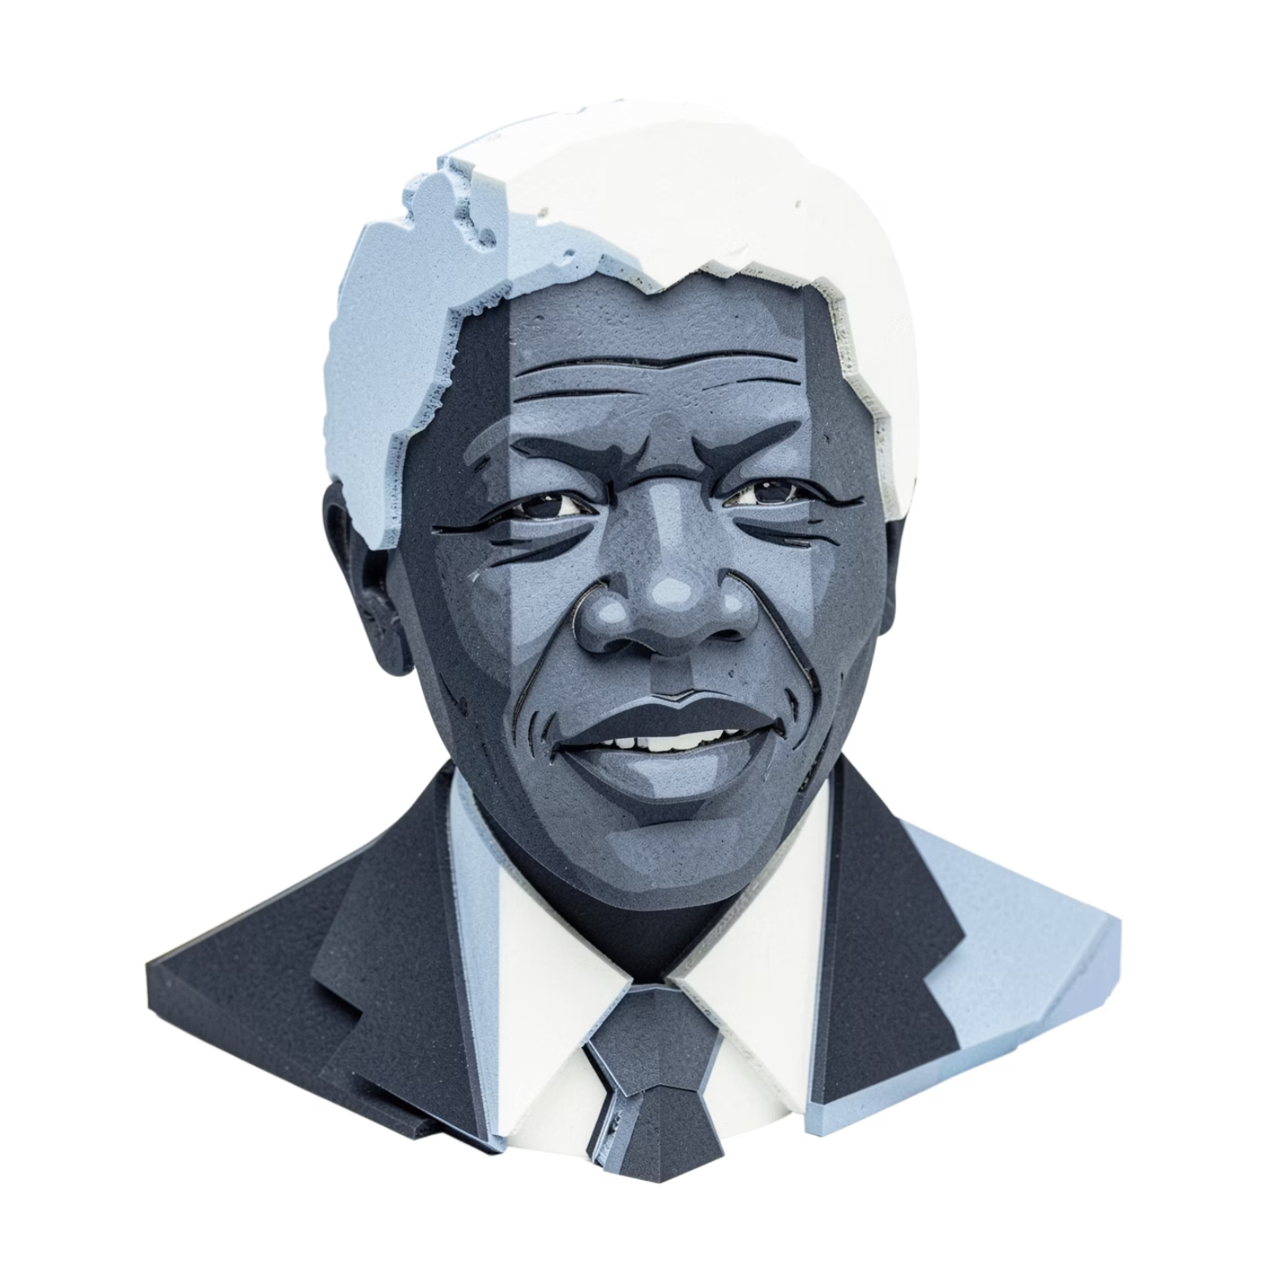
CHAPTER 3
Nelson Mandela: From Activist to Prisoner
Early Life & Education
Born on July 18, 1918, in Mvezo, South Africa, Mandela was given the name Rolihlahla ("troublemaker"). He became the first in his family to attend school, later studying law at the University of Fort Hare and the University of Witwatersrand.
Joining the ANC
In 1944, Mandela co-founded the ANC Youth League, committing himself to non-violent resistance. As apartheid hardened, he helped form Umkhonto we Sizwe ("Spear of the Nation"), the ANC's armed wing.
The Rivonia Trial (1963–64)
Arrested and charged with sabotage and conspiracy, Mandela delivered a legendary speech from the dock: "I have cherished the ideal of a democratic and free society… it is an ideal for which I am prepared to die." He was sentenced to life imprisonment.

Slide 6
CHAPTER 4
Robben Island: A Symbol of Resilience
For 18 of his 27 years in prison, Nelson Mandela was held on Robben Island — a maximum-security prison off the coast of Cape Town. Prisoners were confined to tiny cells, given minimal rations, and forced into hard labor in a limestone quarry. Yet Mandela transformed the island into a "university" — educating fellow prisoners, debating politics, and maintaining the spirit of resistance.
Cell No. 466/64
The Island University
Unbroken Spirit
Mandela's cell was just 2.4m × 2.1m. His prisoner number, 466/64, became a global symbol of the anti-apartheid struggle.
Prisoners organized political education classes, turning Robben Island into a crucible of leadership and ideological clarity.
Despite harsh conditions, Mandela refused offers of release that required him to renounce violence. His integrity inspired the world.

Slide 7

CHAPTER 5
The Global Anti-Apartheid Movement
International Pressure Mounts
The world could not ignore apartheid. Nations imposed economic sanctions, cultural boycotts, and sporting bans on South Africa. The United Nations condemned the regime. Musicians, artists, and athletes refused to perform or compete in South Africa.
Free Nelson Mandela Campaign
The slogan "Free Nelson Mandela" became a rallying cry worldwide. Massive concerts like the 1988 Nelson Mandela 70th Birthday Tribute at Wembley Stadium reached 600 million viewers across 67 countries. Governments, universities, and civil society groups joined the call for his release.
27
600M
1990
Years Imprisoned
Concert Viewers
Year of Release
Mandela spent 27 years behind bars, from 1964 to 1990.
The 1988 Wembley tribute broadcast reached 600 million people globally.
On February 11, 1990, Mandela walked free — a moment watched by the entire world.

Slide 8
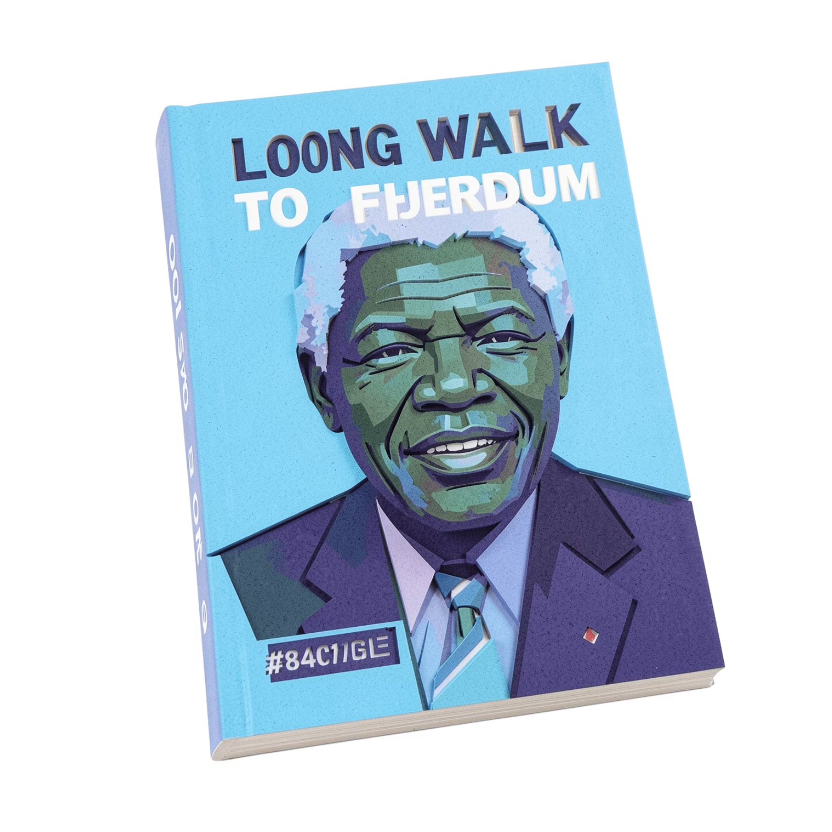

CHAPTER 6
"A Long Walk to Freedom": Mandela's Autobiography
A Life Written in His Own Words
Published in 1994, Long Walk to Freedom is Mandela's autobiography — a deeply personal account of his journey from a rural Xhosa boy to a global icon of justice. The book covers his childhood, education, political awakening, years of armed struggle, the Rivonia Trial, and nearly three decades of imprisonment.
Why It Matters
The autobiography is not just a memoir — it is a testament to the human spirit. Mandela writes with honesty about his doubts, his anger, and his evolving philosophy of forgiveness. He reveals how hatred was replaced by a vision of reconciliation. The book remains essential reading for anyone seeking to understand the cost and meaning of freedom.
Key Quote: "For to be free is not merely to cast off one's chains, but to live in a way that respects and enhances the freedom of others." — Nelson Mandela

Slide 9
CHAPTER 7
Release and Reconciliation: A New Dawn
On February 11, 1990, Nelson Mandela walked through the gates of Victor Verster Prison a free man. His release sent shockwaves of joy across the world. But Mandela's greatest work was yet to come — building a new, democratic South Africa.
1990
1994
Mandela released. ANC unbanned. Negotiations for democracy begin.
South Africa's first democratic election. Mandela becomes President.
1
2
3
4
1993
1995
Mandela and de Klerk awarded the Nobel Peace Prize for peaceful transition.
Truth and Reconciliation Commission established under Archbishop Desmond Tutu.
The Truth and Reconciliation Commission (TRC) was revolutionary — instead of punishing apartheid-era crimes through vengeance, it offered amnesty in exchange for truth. Victims were given a voice. It was a bold experiment in restorative justice that the world watched with awe.

Slide 10
LEGACY
Legacy of Emancipation: A Continent Inspired
Nelson Mandela's struggle did not just free South Africa — it ignited a flame of hope across the entire African continent and beyond. His life proved that dignity, forgiveness, and reconciliation are more powerful than hatred and revenge.
🌍 Continental Inspiration
⚖️ A Model for Justice
🔥 The Ongoing Journey
Mandela's example inspired liberation movements and democratic transitions across Africa, from Zimbabwe to Nigeria to Rwanda's post-genocide recovery.
The Truth and Reconciliation Commission became a global model for post-conflict societies seeking healing over vengeance.
Post-emancipation Africa still faces poverty, inequality, and corruption — but the foundation Mandela helped build endures. The walk to freedom continues.
"Let freedom reign. The sun never set on so glorious a human achievement." — Nelson Mandela, May 10, 1994, Presidential Inauguration

Slide 11
Key Themes and Lessons from Mandela's Journey
Courage in Adversity
Power of Forgiveness
Unity and Solidarity
The willingness to sacrifice personal freedom for collective liberation
Choosing reconciliation over revenge, even after decades of suffering
How global movements and local resistance combined to defeat apartheid
Moral Leadership
Leading by example and maintaining integrity under impossible circumstances
"The greatest glory in living lies not in never falling, but in rising every time we fall." — Nelson Mandela

Slide 12
Critical Analysis: Questions for Reflection
How did Mandela's 27 years of imprisonment shape his vision for a democratic South Africa?
1
Compare the strategies of violent and non-violent resistance in the anti-apartheid movement. Which was more effective?
2
What role did international pressure play in ending apartheid? Could South Africa have changed without global support?
3
How does the Truth and Reconciliation Commission challenge traditional notions of justice and punishment?
4
What lessons from Mandela's struggle are relevant to modern social justice movements?
5
Notes:
These questions encourage deeper engagement with the text and historical context.

Slide 13
Connecting to English Literature and Language
Literary Devices in 'A Long Walk to Freedom'
Language and Rhetoric
Metaphor: "Long Walk" represents the journey toward freedom
Symbolism: Robben Island as a symbol of oppression and resilience
Narrative Structure: Chronological journey from childhood to presidency
Tone: Reflective, honest, and ultimately hopeful
Mandela's use of powerful speeches to inspire change
The importance of storytelling in preserving history
How autobiography as a genre gives voice to marginalized experiences
The role of language in shaping political movements
Mandela's autobiography demonstrates how literature can be a tool for social change and historical documentation.

Slide 14

Bibliography and Further Reading
Primary Sources
1
Mandela, Nelson. "A Long Walk to Freedom" (1994)
Mandela, Nelson. "Speeches and Writings" (1990-1994)
Recommended Books
2
"Mandela: The Authorized Biography" by Anthony Sampson
"The Anti-Apartheid Movement in Britain" by Stephen Howe
"South Africa: A Very Short Introduction" by Robert Ross
Documentaries
3
"Mandela: Long Walk to Freedom" (2013)
"Mandela: The Life and Times" (BBC Documentary)
Online Resources
4
Nelson Mandela Foundation (nelsonmandela.org)
South African History Online (sahistory.org.za)
United Nations Apartheid Archive
These resources provide deeper insights into the historical context and Mandela's legacy.

Slide 15

Thank You
A Long Walk to Freedom: Nelson Mandela's Legacy
Presented by: Viraj Chavan
Class: 10B
Subject: English
Class Teacher: Aboli Mam
Through studying Mandela's life and legacy, we learn that one person's courage and conviction can transform a nation. His journey reminds us that freedom is not just a destination, but a continuous commitment to justice, equality, and human dignity.
"May we all find the strength to walk our own long walk to freedom." — Inspired by Nelson Mandela

